Slide 1
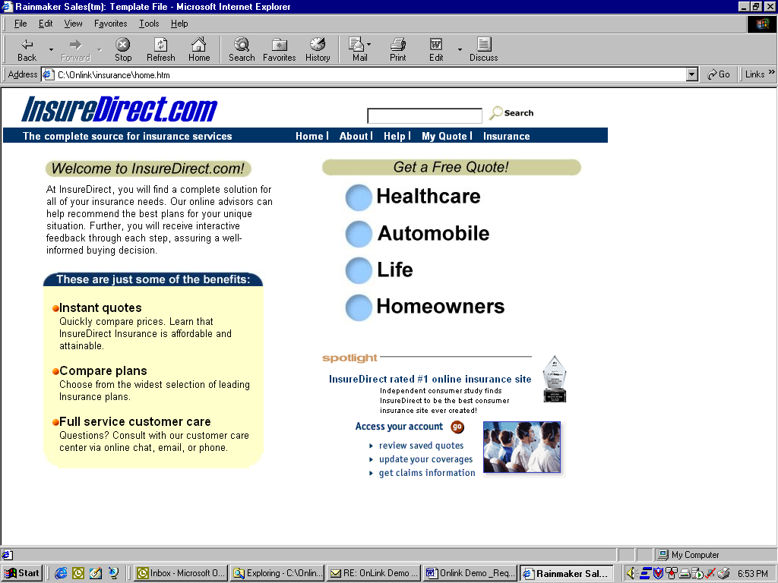
Rebecca-
Page 2 contains all of the changes. I only outlined the textual changes to modify the site from a .com to a traditional health plan. Feel free to use your creative skills to improve the design.
Thanks -Paul

Slide 2
Good Living Health Plan
Healthy living for healthy people
Good Living Health Plan
Are you interested in insurance?
At Good Living we care about your health needs. Our physicians are routinely screened on quality care and are evaluated based on feedback from members. We feel that this process has paid off when we were ranked the most caring plan in our region. Come join our team!
Dental
Dental
Dental
This line should read, “Good Living has been awarded the top healthplan website of 2000.
How can we help you:
Members
Members can access to all health plan services. You can search for a provider, schedule appointments, check your benefits and order an ID card.
Vision
Providers
Our provider portal will enable physicians to answer network, contract and payment inquiries any time day or night
Agents
The broker portal will support agents with all interactions with Good Living Health Plan
Replace with Good Living

